Slide 1


ECO-RIDE CONNECT
A SUSTAINABLE RIDE
TEAM TITANS (BANGALORE)
SUNAINA G P
VARSHA SHETTY
Bangalore Institute of Technology

Slide 2

PROBLEM STATEMENT
This open innovation challenge invites participants from diverse backgrounds to unleash their creativity and propose transformative solutions that transcend traditional notions of transportation. The goal is to reimagine and redefine global mobility, addressing not only safety concerns but also the broader environmental impact. Participants are encouraged to think beyond conventional boundaries and contribute ideas that can revolutionize the way we move and connect.

Slide 3
OVERVIEW
As urbanization surges and traffic congestion plagues our cities, carpooling emerges as a powerful eco-conscious solution. It encourages individuals to share rides and resources, resulting in fewer vehicles on the road, reduced greenhouse gas emissions, and more efficient resource utilization.
Carpooling addresses two pressing environmental challenges: traffic congestion and air pollution. By promoting ride-sharing, it reduces the number of vehicles on the road, easing congestion and lowering fuel consumption and emissions, benefiting both the environment and public health.
Beyond environmental benefits, carpooling is cost-effective, helping individuals save on fuel and maintenance expenses. It fosters a sense of community and social interaction, connecting like-minded individuals with common destinations and environmental goals.

Slide 4
TECHNICAL OVERVIEW
This carpooling application provides a user-centric platform for both drivers and passengers, offering a range of features to facilitate ride-sharing and promote eco-friendly transportation.
User Management: Users can easily register and log in, creating personalized profiles within the app, which includes personal information, preferences, and ride history.
Ride Discovery: The application provides a comprehensive catalog of available rides, including information on the start and end points, pricing, and driver details. Users can browse this catalog to find suitable rides that match their requirements.
Ride Details: Users can access detailed information about specific rides, reviewing the ride offer, pricing, and other relevant details to make informed decisions.
Ride Requests and Offers: Passengers can request rides from drivers, agreeing to the specified conditions. Drivers, on the other hand, can create ride offers, specifying the journey details and pricing.
Ride Management: Users can keep track of their ride requests and offers, allowing for easy cancellation if necessary, as well as editing ride offers as circumstances change.
Profile Management: Both passengers and drivers can edit their user profiles, updating personal information, preferences, and contact details.

Slide 5
HOW DO WE STAND OUT?
Environmental Leadership: Emphasize your unwavering commitment to reducing carbon emissions and environmental impact, positioning your platform as a leader in eco-friendly transportation.
Sustainability Metrics: Offer users clear information on how their carpooling contributes to reduced emissions, less traffic congestion, and improved air quality.
Environmental Challenges: Organize eco-friendly challenges and campaigns that encourage users to compete or collaborate in reducing their carbon footprint. Offer rewards for the most environmentally responsible users.

Slide 6
TECH STACK
FRONTEND:-
1) HTML
2) CSS
3) JAVASCRIPT
4) REACTJS
BACKEND:-
1) NODEJS
2) MONGO DB

Slide 7
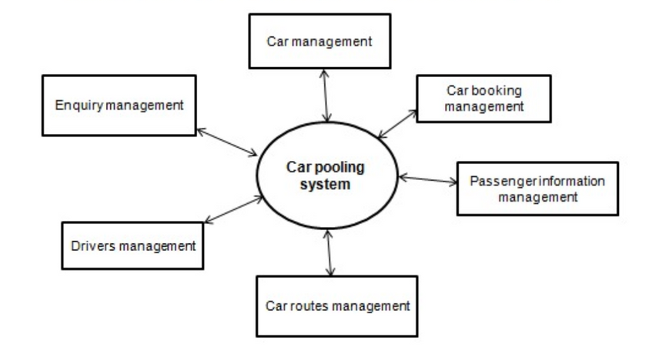
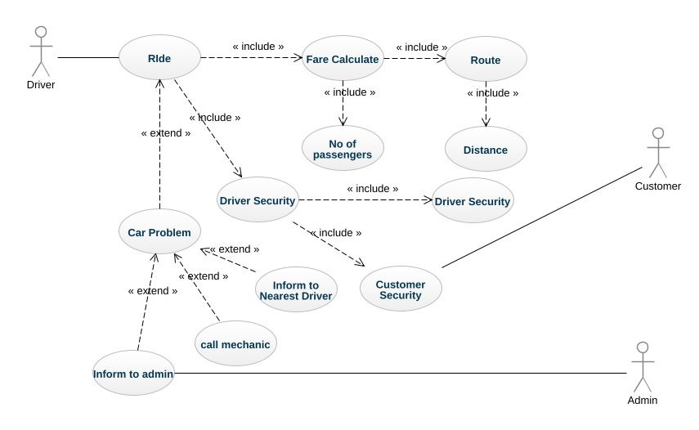
UML DIAGRAM

Slide 8
PROTOTYPE
DEMO

Slide 9
FUTURE PROSPECTS
Recommendation System for Like-Minded Carpooling: Create a smart recommendation system that matches people with similar routes and schedules for shared rides, reducing the number of cars on the road and promoting a sense of community around eco-friendly travel.
Incentives for Carpooling: Offer coupons and rewards to individuals who actively participate in carpooling, providing tangible benefits and encouraging more people to choose shared transportation options, thus reducing carbon emissions and fostering sustainable lifestyles.
Climate Change Awareness Campaign: Launch a targeted campaign to raise awareness about the impact of individual transportation choices on the environment, emphasizing the role of carpooling in reducing air pollution, traffic congestion, and overall carbon footprint, while advocating for broader eco-friendly behaviors.

